Slide 1
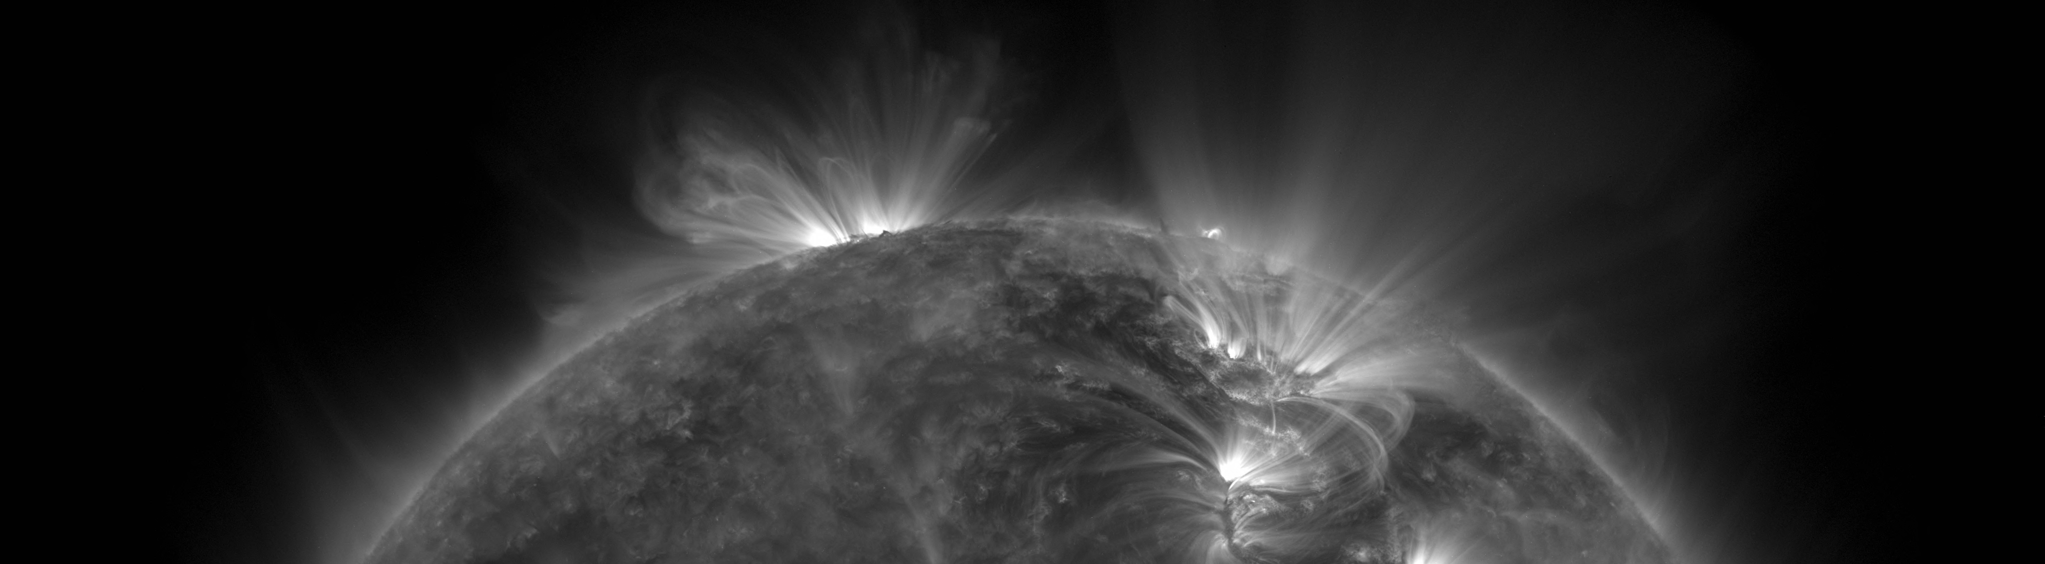
EUV Solar Telescope Using Fresnel Zone Plates
Roy Smart
EELE582 Optical Design
Montana State University

Slide 2
Motivation
The solar atmosphere is often investigated by using extreme ultraviolet (10nm-124nm) telescopes.
Building optical systems in this regime is difficult since EUV photons are absorbed by all known elements.
Requires using space-based observatories
Current EUV imaging systems use multilayer reflective optics to focus light.
EUV multilayer optics are difficult to design and extremely expensive to produce.
Can we do better?

Slide 3
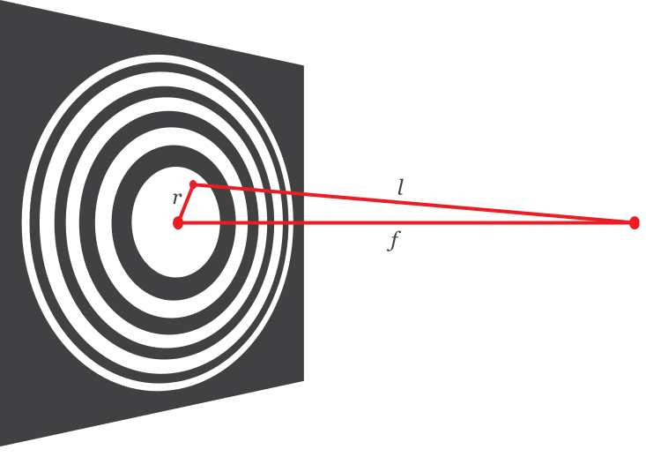
Introducing the Fresnel Zone Plate
Diffractive imaging system.
Plate is divided into zones, alternating between opaque and transparent.
Zones are placed such that incoming plane waves constructively interfere at the focus.
Good candidate for EUV imaging.

Slide 4
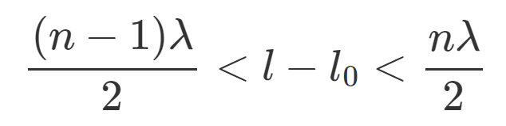
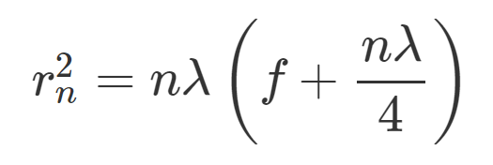
Fresnel Zone Plate Theory
The condition for constructive interference at the focus is
The radius where the zone plate switches from opaque to transparent is then

